Slide 1
Theory of Programming Languages (Lab) Case Study
Submitted by:
Jannah R. Soriano
Rosh Hashana S. Torres

Slide 2
Thank you!

Slide 3
COMPILER LEXICAL | SYNTAX | SEMANTICS
By:
Jannah R. Soriano
Rosh Hashana S. Torres

Slide 4
WHAT IS A COMPILER?
A special program that translates a programming language's source code into machine code, bytecode or another programming language.

Slide 5
WHAT ARE THE PHASES OF COMPILER?
01
02
03
Lexical Analysis
Syntax Analysis
Semantic Analysis
04
05
06
Intermediate Code Generator
Code Optimizer
Code Generator
First phase when compiler scans the source code.
All about discovering structure in code.
Checks the semantic consistency of the code.
Generates intermediate code for the target machine.
Removes unnecessary code line and arranges the sequence of statements.
Produces the page code or object code as a result.

Slide 6
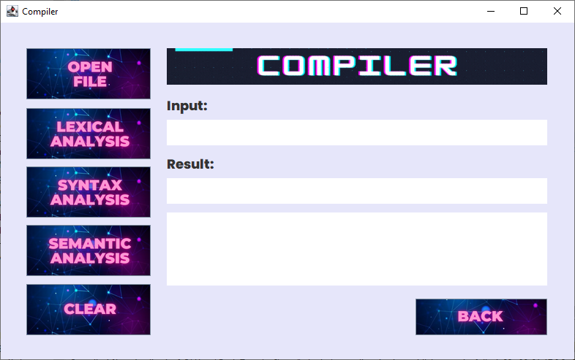
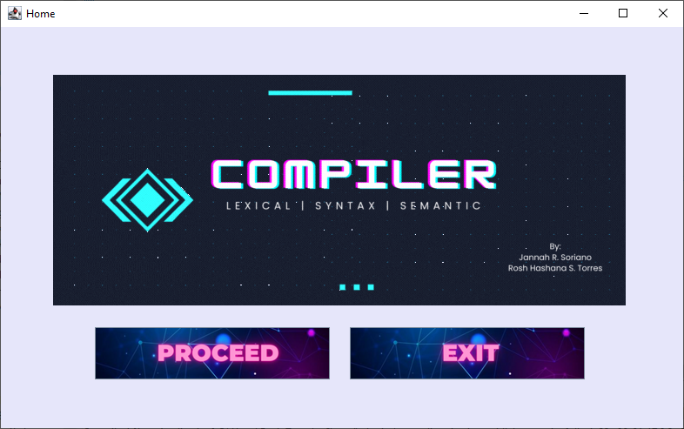
Home
Compiler

Slide 7
HOME WINDOW

Slide 8
HOME WINDOW
Proceed
button
Exit
button

Slide 9
COMPILER WINDOW

Slide 10
COMPILER WINDOW
Open File
button
Lexical Analysis
button
Syntax Analysis
button
Back
button
Semantic Analysis
button
Clear
button

Slide 11
COMPILER WINDOW
Input
text area
Result
text area
Code
text area

Slide 12
DEMONSTRATION

